Slide 1
AUDENCIA BUSINESS SCHOOL
TO WHAT EXTENT CAN LEAN MANAGEMENT BE IMPROVED BY INTEGRATING AGILE APPROACHES?
Shadi RIZKALLAH
MANAGEMENT AND INTERNATIONAL COMPETENCIES

Slide 2


A BRIEF HISTORY OF PM
Today
To what extent can lean management be improved by implementing agile approaches?
1962
Work breakdown structure-WBS
2001
The Agile Manifesto
1957
1969
1988
1996
Critical path method Dupontt coorporation
PMI
OHNO method-lean
PRINCE 2
1917
Gantt chart-Henri Gantt

Slide 3
LEAN

Slide 4



LEAN PRINCIPLES-OHNO
MUDA (Wasteful)
Waste detection
Minimum amount of input
Value creation
1
2
2
3
4
5
6
7
WAITING
OVERPRODUCTION
REWORK
MOTION
PROCESSING
INVENTORY
TRANSPORTATION
MURA (Unevenness)
Waste due to non-uniformity
Waste due to inconsistency
Avoid effort fluctuation
MURI (Overburden)
Workforce stress
Decrease human productivity
Decrease Motivation
Overload on the human factor

Slide 5
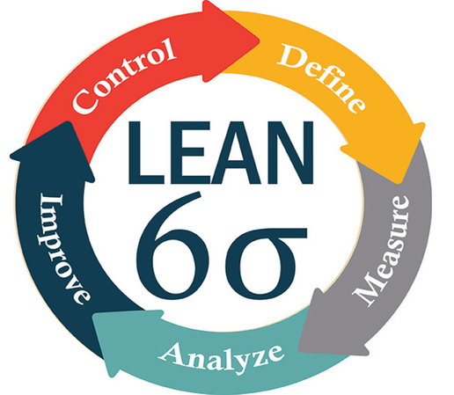
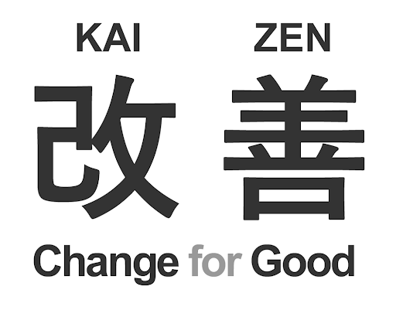
LEAN FRAMEWORKS
KAIZEN
Lean six sigma

Slide 6
AGILE

Slide 7

WHAT IS AN AGILE MINDSET?
Better management by being adaptive
Self-organisation
Incremental product delivery
Operating iteratively
Rapid flexible response
Idenify and accepting uncertainty

Slide 8
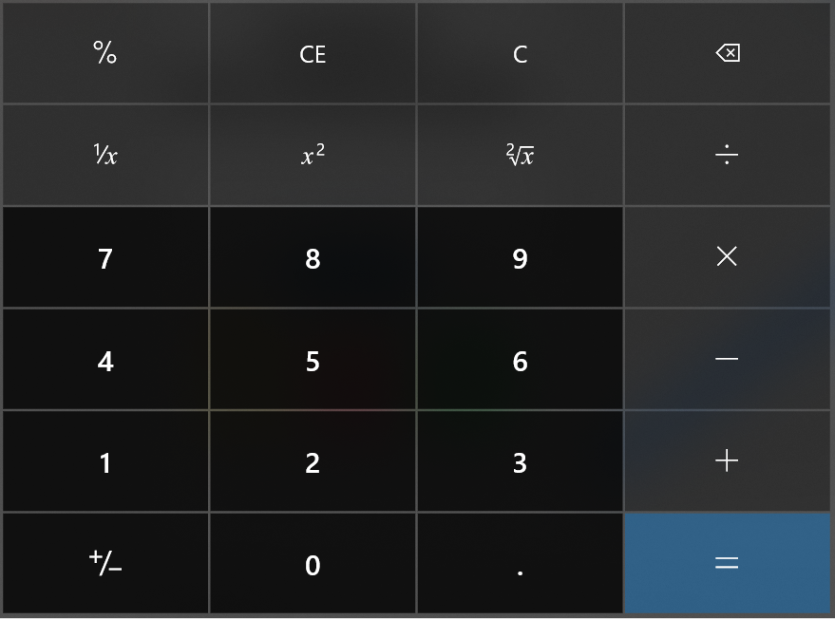
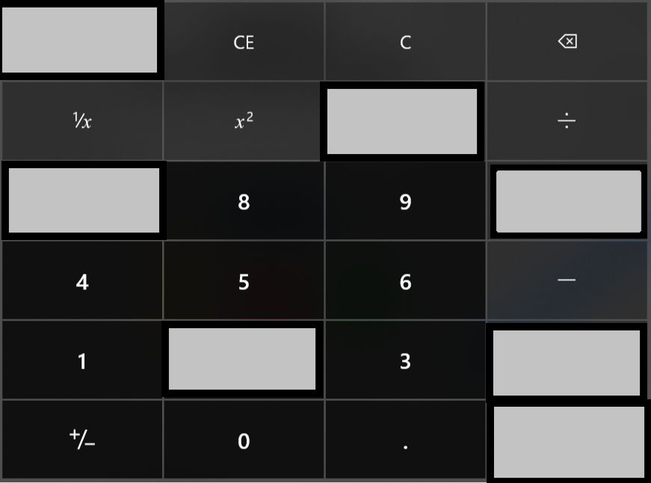





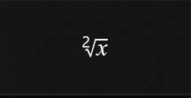

AGILE FRAMEWORK-SCRUM
54%
MOST USED
Daily meeting
24
hours
Product: Digital calculator
30
days
Sprint
Product Backlog
Sprint Backlog
Working increment of the product

Slide 9
AGILE FRAMEWORK-KANBAN
Stories
To Do
In Progress
Testing
Done

Slide 10
TO WHAT EXTENT CAN LEAN MANAGEMENT BE IMPROVED BY IMPLEMENTING AGILE APPROACHES ?

Slide 11

RESEARCH FRAMEWORK
To what extent can lean management be improved by integrating agile approaches?
FEASIBLE APPROACHES
HUMAN FACTOR
Self-organized teams
How?
Maturity level
Lean vs Agile
Working in iterations
Advantages?
Workforce awareness
Education vs Awareness
Daily briefing
Conditions?
Workforce tendencies
Optimizing contribution
Retrospective meetings
Obstacles?

Slide 12










METHODOLOGICAL ORIENTATION
HUMAN FACTOR- Quantitative method
FEASIBLE APPROACHES – Qualitative Method
250 Responses min
12 Questions - 3 sections
Semi-structured interviews
9 Interviewees
Self-administrated Survey
Current and Future workforce
Decision Making
11 questions - 5 objectives

Slide 13
QUANTITATIVE METHOD

Slide 14



QUANTITATIVE METHOD
OBJECTIVES
SAMPLING CRITERIA
Determine the level of awareness of both mindsets
Diversity of sectors with equal proportions of lean and agile fields
Determine if the level of maturity is linked to the level of education
Actively working or studying
ACTUAL RESPONSES
LEAD GENERATION
661
316
269
TOTAL VIEWS
PARTICIPANTS
COMPLETE RESPONSES
LINKEDIN
FACEBOOK
YOUTUBE

Slide 15
QUALITATIVE METHOD

Slide 16
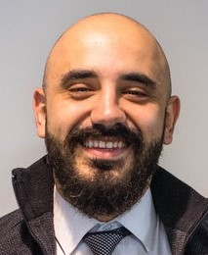
INTERVIEWEES PROFILES
Interviewed by
A
DEPARTMENT HEAD CONSTRUCTION
D
PROJECT ENGINEER
CIVIL
B
PROJECT ENGINEER MECHANICAL
Paul ReyesA
pp Developer
Shadi RIZKALLAH
MCI STUDENT
C
SENIOR CONSULTANT MANAGEMENT
E
CONSULTANT DIGITAL TRANSFORMATION
William Hendels
Production
G
CONSTRUCTION MANAGER CIVIL
F
CONSULTANT
L & D
H
CONSTRUCTION MANAGER CIVIL
I
CONSTRUCTION MANAGER CIVIL
Corrie Lovelace
Software Architect

Slide 17
Determine the maturity level of lean and agile practices
Communalities between both mindsets
THE INTERVIEW OBJECTIVES
Focus on iterations and the feasibility of integrating it in lean process
Focus on self-organisation and the feasibility of integrating it in lean process
Focus on Daily briefing and retrospective meetings and the feasibility of integrating them in lean process

Slide 18
INTERVIEW FINDINGS

Slide 19





INTERVIEWS FINDINGS
Self-organized teams
Working in iterations
Own the process and are the most qualified to identify waste in it
Waste detection on smaller scale, easier to achieve
Freedom of decision allows faster actions
Achieved by dividing the workflow into smaller iterations that are planned and realised independently
Optimized tasks distribution
Limited to the execution phase
Delivering independent parts of the product is not applicable in lean sectors.
Lack of accountability
Defining the scale of iteration (time, cost, product)
Conditioned by the collaboration between team members, the skills, experience and training
Advantages
Limitations

Slide 20
Daily briefing
Maturity level
Vary widely between companies
Increase motivation and Keep team members focused and target-oriented
Direct link to change resistance
Raising obstacles faced by team member
Discussing the goals of the day and the progress, identifying shortcomings, sharing ideas
Efficient trainings and correct practices
to face these obstacles
Potential poor level of commitment and investment
Retrospective meeting
Communalities
Add value to the final product,
and target customer satisfaction
Podium for evaluation and improvement
Facilitate communication, and increase the lesson learnt
Value the human factor and relies on it
Reminder role to check inventory
No serious attempts to implement agile into manufacturing, due to lack of trying, competencies, or avoiding risk
Considered as a waste of time
Determine occurrence frequency

Slide 21
SURVEY FINDINGS

Slide 22
SURVEY FINDINGS
53%
are Students-Recently joined the workforce
IT, CS
21.2%
Others
39.6%
71%
Prefers Working in an agile environment
PROFILE DISTRIBUTION OF THE PARTICIPANTS
Manufacturing
19.3%
79%
Have level of education equal or more than BAC+5
Management and business
19.9%

Slide 23
SURVEY FINDINGS
27%
37%
Agreed that identifying waste in self managed team leads to pressure
Believe they are not capable to identify waste in their process
Unfamiliar
Never Practiced
Practiced
Masters
Unfamiliar
Never Practiced
Practiced
Masters
FISHBONE DIAGRAM
KANBAN
KAIZEN
SCRUM
ROOT CAUSE ANALYSIS
SELF-ORGANISATION
VALUE STREAM MAPPING
UNCERTAINTY CONE
WASTE IDENTIFICATION
WORKING IN ITERATIONS
OPTIMISATION

Slide 24

SURVEY FINDINGS
LEVEL OF MATURITY
AGILE VS LEAN
Low level of maturity and tools and techniques' awareness
The survey results show that participants prefer working in an agile environment
EDUCATION VS AWARNESS
OPTIMISING HUMAN FACTOR
No direct link between the level of education and the level of lean and agile awareness
Achieved by training and coaching, change management and creating motivational environments

Slide 25
CONCLUSION

Slide 26


IMPROVING THE LEAN PROCESS
INTEGRATING THE 4 APPROACHES
MURA
Working in iterations
Self-organization
Daily briefing
Retrospective meetings
Continuous improvement
Waste elimination
Accelerating the process
OPTIMISING HUMAN FACTOR
Trainings
Coaching
Inspiring a shared vision
Change resistance solutions
MURI
Reducing stress
Increasing Productivity

Slide 27

How would it work ?
P.S:Video link in the notes
Notes:
https://youtu.be/jwVu8urt81Q

Slide 28
Thank you!
Do you have any questions?

